Slide 1

Azure App Service Project using Terraform

Slide 2
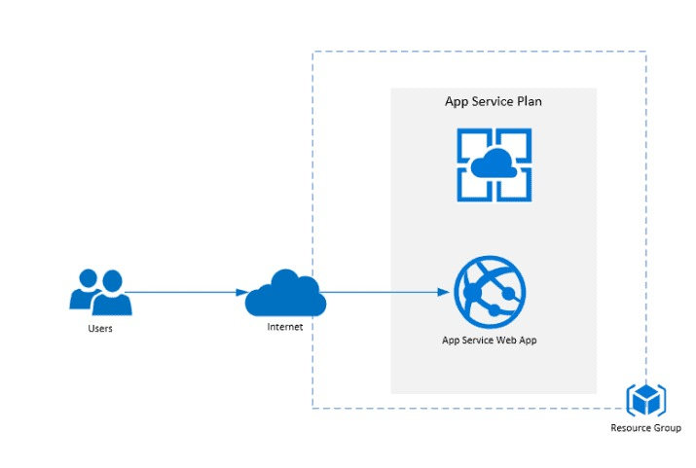
Design Flow

Slide 3

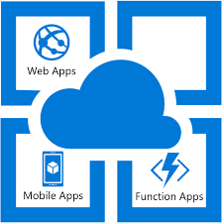
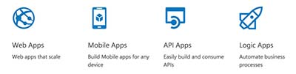
App Service overview
Azure App Service is considered an excellent Platform as a Service (PaaS).
It is an HTTP-based service for hosting web applications, REST APIs, and mobile back ends.
We can deploy using .NET, .NET Core, Java, Ruby, Node.js, PHP, or Python.
Applications run and scale with ease on both Windows and Linux-based environments.
It has multiple features which makes it easy to manage deploy and monitor the application.
Ref: https://docs.microsoft.com/en-us/azure/app-service/overview

Slide 4
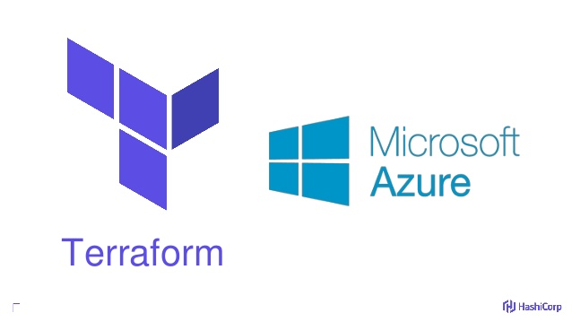
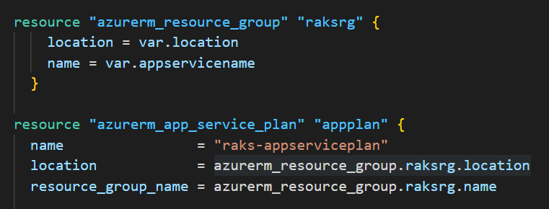
Terraform on Azure
Hashicorp Terraform is an open-source IaC (Infrastructure-as-Code) tool for provisioning and managing cloud infrastructure.
Terraform can used with multiple cloud providers is the great benefit.
Typical module Structure:
Resources
Input variables
Output values

Slide 5

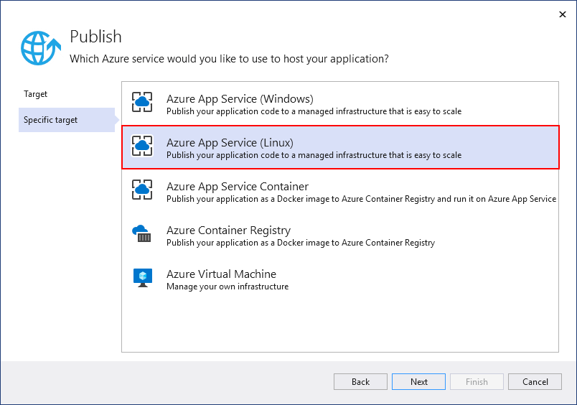
Visual Studio | Azure
The publishing features of Visual Studio 2022 is used to deploy and manage an ASP.NET Core web application hosted on Azure.
The Website link :
https://raks1appserve.azurewebsites.net/

Slide 6
Thank you

